Slide 1
Week 14-15

Slide 2
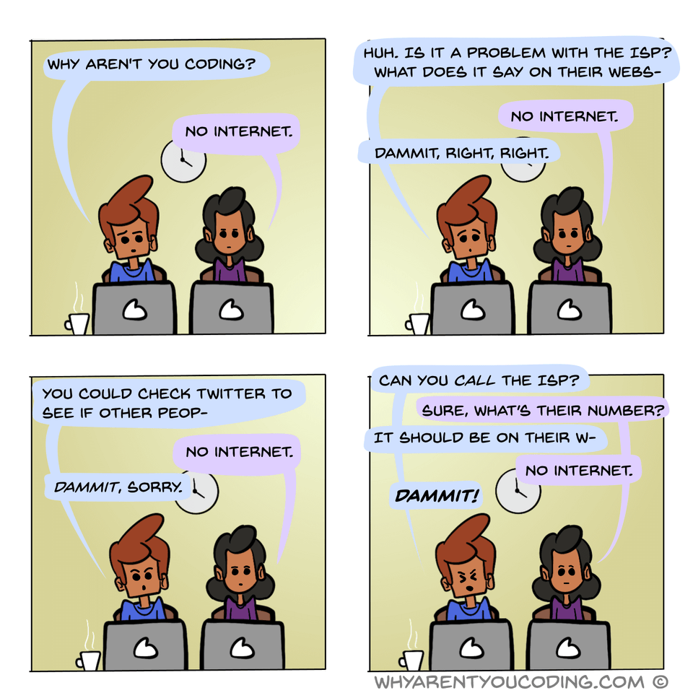

Slide 3
Updates - Schedule
Quiz 6 - 12/2
Final - 12/7
1 attempt
Comprehensive-ish
Open 8:00 AM to 11:59 PM
2 hours once started
Course Evals:
Pilot Home Page -> My Course Evaluations
Available until 12/4/2021 11:59 PM

Slide 4
Updates - Lab Schedule
Lab 11 - 12/3 - systems stuff / random
Late window until 12/6
Lab redos - 12/10
07 - 11

Slide 5
Humble Bundles of Coolness
Python Skilz
https://www.humblebundle.com/books/python-programming-oreilly-books
“Hacking” & Cyber Security
https://www.humblebundle.com/books/hacking-by-no-starch-press-books

Slide 6
Network Security

Slide 7
VPN - Virtual Private Network
Org with many locations want to connect to one big private network
Secure & encrypted tunnel among locations
Client downloads VPN client
Implements VPN connectivity back to network
WSU VPN
Occasionally implements a “split tunnel” - looks to see if destination is to a WSU address - if yes, use VPN. Else use normal network

Slide 8
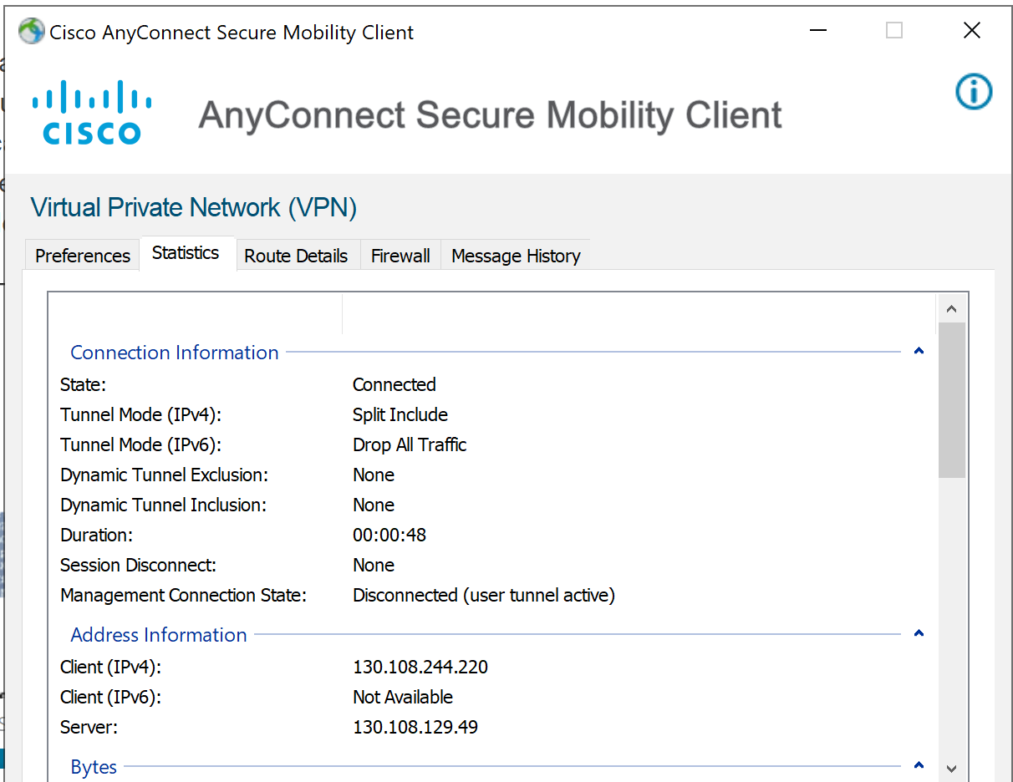

Slide 9






Network vs Machine Firewalls
Apply to the network as a whole
Your home router can have firewalls configured
AWS - Security Groups

Slide 10


Types of packet filter firewalls
Stateless filters check basic information like port number, IP address, protocol, etc. of a packet to take action.
Stateful filters maintain records of connections passing through, can determine if a packet is the start of a new connection or a part of an existing connection. In iptables the four trackable states are NEW, ESTABLISHED, RELATED and INVALID.

Slide 11
Security groups
Manage rules for the overall network (VPC)
Inbound rules
Allowed subnet and for which ports that might be listening in the network
Must be set for internal and external requests
Outbound rules
What is allowed to go out from the network and where
Allow certain ports to certain sites.
Request to an update site (for example)
Outbound connections are allowed to get responses despite inbound rules
This would be a parallel to a network firewall appliance on a physical network

Slide 12
Firewall policies
Blacklist approach (default-allow)
All packets are allowed through except those that fit the defined blacklist.
Pros: flexible, less likely to impact services.
Cons: unexpected malicious traffic makes it through.
Whitelist approach (default-deny)
All packets are dropped or rejected unless specifically allowed.
Pros: safer network
Cons: unexpected important traffic gets dropped or rejected.
Notes:
https://github.com/mkijowski/ceg3400/tree/master/firewalls

Slide 13
Firewalls + packets
Firewalls take one of three actions on a packet.
Allow lets the packet pass through.
Drop prevents the packet from passing but is silent about it.
Reject prevents the packet from passing but notifies the sender that it is being blocked.
Action criteria:
Source / destination IP address or subnet
Source / destination port
Network interface

Slide 14
iptables
iptables specfically has multiple chains of rules that apply, here are the 5 predetermined ones:
PREROUTING are rules applied to all packets before any routing decisions are made.
INPUT are rules applied on packets that will be delivered locally.
FORWARD are rules applying to packets that have been routed but are not for locally delivery
OUTPUT are packets sent by the local machine.
POSTROUTING again are all packets but after they have been through all previous relevant chains.

Slide 15
# iptables -L
# iptables -P INPUT DROP
-P = policy
# iptables -flush

Slide 16


# iptables -L
# iptables -A INPUT -s 192.168.34.68 -j DROP
-A = appends a rule to the INPUT chain
-s = specifies source IP
-j = what to do with the matching rule (DROP)
# iptables -A INPUT -s 192.168.34.0/24 -p tcp --destination-port 25 -j DROP
# iptables -A INPUT -s 192.168.34.37 -j ACCEPT
# iptables -D INPUT 3
-D = delete a rule
# iptables -I INPUT -s 192.168.34.37 -j ACCEPT
-I = capital i = insert

Slide 17
Be careful creating rules
You can lock yourself out of SSH if you DROP all before allowing trusted SSH networks
But not to worry…
Iptables when set via the command line are like aliases - non-permanent until you set the configuration to auto load on boot
Exercise: create an SSH allow rule for trusted network(s)

Slide 18
More firewall resources
https://www.booleanworld.com/depth-guide-iptables-linux-firewall/
https://www.redhat.com/sysadmin/iptables
http://linux-training.be/networking/ch14.html
https://github.com/mkijowski/ceg3400/tree/master/firewalls

Slide 19



Fail2Ban vs PSAD
Fail2BAN scans log files of various applications such as apache, ssh or ftp and automatically bans IPs that show the malicious signs such as automated login attempts.
Think service level
PSAD on the other hand scans iptables and ip6tables log messages (typically /var/log/messages) to detect and optionally block scans and other types of suspect traffic such as DDoS or OS fingerprinting attempts. It's ok to use both programs at the same time because they operate on different level.
Think ip level

Slide 20
Networking Applications

Slide 21
Application Layer
The “language” that applications and servers use to communicate
Common protocols:
HTTP - Hypertext Transfer Protocol
TLS - Transport Layer Security - encryption protocols
HTTPS - HTTP + TLS
FTP - File Transfer Protocol
SFTP

Slide 22
HTTP - 80
HTTP - Hyper Text Transfer Protocol
The messages sent by the client, usually a Web browser, are called requests and the messages sent by the server as an answer are called responses.
Requests are initiated by recipient / user-agent
Web browser - Chrome, Firefox, Opera, DuckDuckGo, Safari, Edge
Search index bot
$ curl hostname
$ wget hostname
Notes:
https://developer.mozilla.org/en-US/docs/Web/HTTP/Overview

Slide 23


The flow of HTTP
1. Client opens TCP connection
2. Client sends an HTTP message:
GET / HTTP/1.1
Host: developer.mozilla.org
Accept-Language: fr
5. Reads response sent by server
POST requests send back to server (like form filling)
3. Server has service listening on port 80
Common: apache2, nginx, react, flask
Or server is a proxy to backend content pool
4. Sends client response:
HTTP/1.1 200 OK
Date: Sat, 09 Oct 2010 14:28:02 GMT
Server: Apache
Last-Modified: Tue, 01 Dec 2009 20:18:22 GMT
ETag: "51142bc1-7449-479b075b2891b"
Accept-Ranges: bytes
Content-Length: 29769
Content-Type: text/html
Notes:
https://developer.mozilla.org/en-US/docs/Web/HTTP/Overview

Slide 24
HTTPS - 443
HTTPS - Hyper Text Transfer Protocol Secure
TLS / SSL encryption over HTTP
Standard protocol for all websites, whether or not they exchange sensitive data with users
HTTPS adds encryption, authentication, and integrity to the HTTP protocol

Slide 25


Digital Certificates
Certificate Authority – the maintainers of the certificate keys. Unlike the private / public keys we create, certificates for sites have an expiration date, then they need to be renewed.
You may have seen a certificate expired warning on a webpage.
When you request a cert, you get a key pair
Private key is kept secure and private to the server
Public key is handed out to connecting client
Client / application (browser) checks if cert is valid
Notes:
https://www.ssl.com/faqs/what-is-https/
https://www.cloudflare.com/learning/ssl/what-is-https/

Slide 26
Certificate Authorities & Trust
CAs use three basic validation methods when issuing digital certificates. The validation method used determines the information that will be included in a website’s SSL/TLS certificate:
Domain Validation (DV) simply confirms that the domain name covered by the certificate is under the control of the entity that requested the certificate.
Organization / Individual Validation (OV/IV) certificates include the validated name of a business or other organization (OV), or an individual person (IV).
Extended Validation (EV) certificates represent the highest standard in internet trust, and require the most effort by the CA to validate. EV certificates are only issued to businesses and other registered organizations, not to individuals, and include the validated name of that organization.
Notes:
https://www.cloudflare.com/learning/ssl/what-is-https/

Slide 27
HTTPS pros and cons
Browsers are pushing to drive out HTTP only:
Google prioritizes HTTPS in search results
Firefox has an HTTPS only mode
New standards (HTTP/2) designed to make the web faster require HTTPS encryption
Third parties can’t look at your data (ads via ISP)
Packets can still be snooped for IP, port numbers, session duration, amount of info exchanged
Scammers can get certificates for their scam servers, too.
In theory, they’re only prevented from impersonating sites they don’t own.
https://downloadmoreram.com/
Notes:
https://www.howtogeek.com/181767/htg-explains-what-is-https-and-why-should-i-care/
https://www.cloudflare.com/learning/ssl/what-is-https/

Slide 28







Slide 29


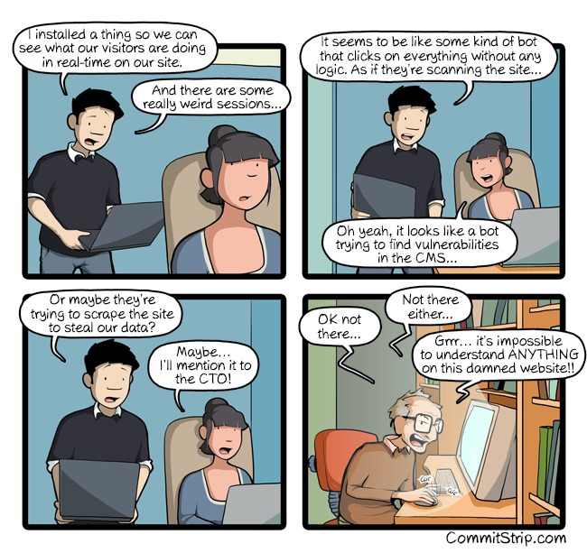



Segway: Cookies & Tracking
Notes:
https://www.commitstrip.com/en/2020/10/21/weird-bots/

Slide 30
Cookies (Nom nom?)
A cookie is information saved by your web browser.
When you visit a website, the site may place a cookie on your web browser so it can recognize your device in the future.
If you return to that site later, it can read that cookie to remember you from your last visit and keep track of you over time. (That friendly “Remember Me” button gets you a cookie)
It is not evil, but it can be abused

Slide 31
Why are cookies everywhere?
Data collection
Persistent session management
PHP Cookie: https://www.geeksforgeeks.org/php-cookies/
Google Webmaster Tools: Require a cookie to track stats.
Good news, companies now need to tell you if they are going to use a cookie and what they will do with it:
https://www.digitalocean.com/legal/privacy-policy/
Sidebar: believe them as you wish

Slide 32
https://www.humblebundle.com/books/python-programming-oreilly-books?hmb_source=&hmb_medium=product_tile&hmb_campaign=mosaic_section_1_layout_index_1_layout_type_threes_tile_index_3_c_pythonprogrammingoreilly_bookbundle

Slide 33
SSH - 22
Secure Shell - protocol for remote logins and for securing network services on an insecure network
Remote command execution
Shell access
File transfer protocol
Port forwarding
Network proxy services
VPN tunneling

Slide 34
Setting up SSH
Client side ~/.ssh
$ ssh-keygen
config file - list of configurations to connect to systems
known_hosts file - unique key from server (passed on first
Server/host side
Must have SSH server installed and listening for connections
~/.ssh/authorized_keys file - list of public keys for users who can log in as the user
/etc/ssh/sshd_config - includes allowing root (discouraged), allowing password auth (discouraged) and much more

Slide 35
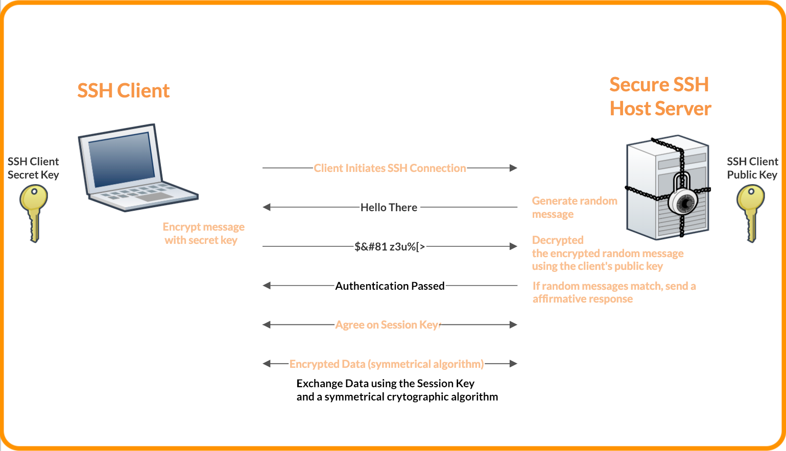




How SSH Encryption Works
Notes:
https://www.foxpass.com/blog/learn-ssh-keys-in-minutes/

Slide 36
More learning resources
https://www.foxpass.com/blog/learn-ssh-keys-in-minutes/
https://www.hostinger.com/tutorials/ssh-tutorial-how-does-ssh-work
https://phoenixnap.com/kb/how-does-ssh-work
https://www.youtube.com/watch?v=hQWRp-FdTpc&ab_channel=TraversyMedia

Slide 37
SFTP & SCP - 22
$ scp = secure copy
Send to: $ scp [-r] file ... [user@]host:[path]
Get from: $ scp [-r] [user@]host:file path
$ sftp = secure file transfer protocol
sftp> help
put
get
Both tools use SSH to create the secure tunnel for message passing
Notes:
https://www.ssh.com/academy/ssh/sftp
https://www.digitalocean.com/community/tutorials/how-to-use-sftp-to-securely-transfer-files-with-a-remote-server

Slide 38
More Networking Resources
From occu
http://gaia.cs.umass.edu/kurose_ross/online_lectures.htm
https://decal.ocf.berkeley.edu/labs/b5/
https://www.redhat.com/sysadmin/sysadmin-essentials-networking-basics
Almost a networking textbook
http://engineering.ju.edu.jo/Laboratories/CPE_0907528_networklab_Sep_2016_Fall.pdf
https://www.ibm.com/cloud/learn/networking-a-complete-guide
DIY router:
https://courses.cs.duke.edu/spring10/cps114/labs/lab2/lab2.html

Slide 39











Port wrap-up

Slide 40
TCP vs UDP
TCP – handshake protocol
TCP is a connection orientated protocol with built in error recovery and re-transmission - two way communication channel
Client sends acknowledgement / confirmation response to server, then next data is sent - client can ask for resend if error
HTTP,FTP, SMTP, POP3, IMAP4
https://i.redd.it/z7lutxstrej61.jpg
UDP – Connectionless (voice over ip, video games)
Think spamming out packets until client wants to stop
Great for IOT devices - send data, whatever is caught is caught
Notes:
https://www.guru99.com/tcp-vs-udp-understanding-the-difference.html

Slide 41





nmap
nmap - Network exploration tool and security / port scanner
$ nmap -Pn hostname
In addition to the interesting ports table, Nmap can provide further information on targets, including reverse DNS names, operating system guesses, device types, and MAC addresses.
-Pn: Treat all hosts as online -- skip host discovery
Some admins disable nmap – useful for localhost though (or if you set up an IP address and want to make sure of what ports are in use)
Sample:
$ nmap -Pn 52.164.252.248
https://github.com/vavkamil/awesome-vulnerable-apps

Slide 42
Common Problem with Ports
Need to investigate what port an application is running on
Need to shut down old and use for new
Forgetfullness
$ lsof – prints list of open files
Linux structure, everything “looks” like a file, even a communication port
Pipe output to `grep` to search for useful information

Slide 43
Find if a port is taken: Linux
$ netstat -lntup
-l - prints only listening sockets
-n - shows port number
-t - enables listing of tcp ports
-u - enables listing of udp ports
-p - show the PID and name of the listener’s process
$ ss -lntup
$ lsof -nP -iTCP -sTCP:LISTEN
-p - do not resolve hostnames, show numerical addresses
Return of the grep
$ netstat -lntup | grep :22
Notes:
https://www.tecmint.com/find-open-ports-in-linux/
https://linuxize.com/post/check-listening-ports-linux/

Slide 44
Find if a port is taken: Windows
Resource Monitor -> Network
> netstat -anoy
> netstat -help
Notes:
https://linuxize.com/post/check-listening-ports-linux/

Slide 45
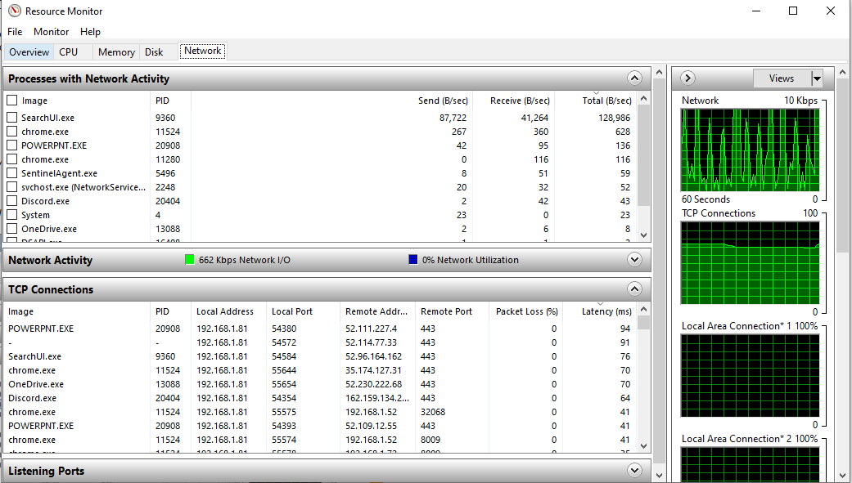

Slide 46
Ports vs. Sockets
If your system is an apartment building, the port is which apartment
Client opens a port (not one bound to a service)
Host has a port listening (bound to a service)
Socket – connection between two computers
IP address + port
Each end of the connection will have a socket.
Notes:
http://www.steves-internet-guide.com/tcpip-ports-sockets/

Slide 47
Socket Tutorials
Python
https://realpython.com/python-sockets/
C/C++
https://www.geeksforgeeks.org/socket-programming-cc/
Java
https://docs.oracle.com/javase/tutorial/networking/sockets/clientServer.html

Slide 48
Port Forwarding
Taking traffic sent out over a port on one system and redirecting it to another
Why?
Machine with better specs can run computations, another machine can get graphical / terminal outputs of results
Virtualizing computationally intensive software (Matlab, Solidworks)
Sending output of an application to local browser (Jupyter)

Slide 49
Jupyter Notebooks
Install pip (python package manager)
$ apt install python-pip/pip3
$ pip3 install jupyter
IDE that runs in web browser
Built for python, can add more compilers / interpreters
Runs on port 8888 of system localhost
Connect to host
http://localhost:8888
Does AWS system have a browser? Negative, server install, no desktop environment
https://coderwall.com/p/ohk6cg/remote-access-to-ipython-notebooks-via-ssh

Slide 50

Notes:
https://git-scm.com/book/en/v2/Git-Branching-Branches-in-a-Nutshell
https://git-scm.com/book/en/v2/Git-Branching-Basic-Branching-and-Merging

Slide 51
Pull a branch
Queries remote for changes that are not on local
In order:
Fetches the changes
Attempts to merge them with local
If successful, no conflicts
If conflicts…

Slide 52
Resolving Merge Conflict
Branches have changes in same file[s]
Remote / local
Merging two branches
Git will highlight the problem areas in the corresponding file[s]
Git will remove the file[s] from tracking while fix in progress
Once fixed / resolved:
$ git add file[s]
$ git commit –a –m “resolved conflicts in file[s]”
$ git push
Push fixed version to remote

Slide 53
Merging – Basic Conflicts
One file changed on main, same file changed locally
Conflict resolution markers added to file(s)
Resolve
$ git add conflicting-files
To mark as resolved
$ git mergetool
Explore for interface to resolve conflicts

Slide 54
Merge Conflicts
2 developers clone a repository in the same moment.
Developer 1 works on a file in the repository, commits and pushes changes to master.
Developer 2 works on the same file, commits their work, and tries to push. They find out their local repository is out of date. To amend, they use git pull. The pull fetches and attempts to merge the remote and local branches. There is a conflict since both developers worked on the same file the Developer 2 needs to resolve.
Once resolved, Developer 2 can now add the file back for tracking, then commit and push now resolved conflict.

Slide 55
Building your Git Skills
https://learngitbranching.js.org/?locale=en_US
https://ohmygit.org/
https://github.com/nivbend/gitstery
https://www.gitkraken.com/learn/git/tutorials
What does version control look like without git?
https://itoshkov.github.io/git-tutorial

Slide 56
File Compression & Verification

Slide 57
Compressing Files
The good old .zip folder.
Putting stuff (files) in a duffel bag and squeezing the air out.
The generic zip compression is quick to compress and quick to unpack
Time efficient, not data efficient
Linux & Macs use different compression tools
https://www.howtogeek.com/178146/htg-explains-everything-you-need-to-know-about-zipped-files/

Slide 58
Compressing Files
gzip (GNU zip)
For a single file:
Compress with `gzip filename`. Use `gunzip filename` to uncompress

Slide 59
Tar Basics
For a folder / series of files / mix of files and folders:
tar cvf archive.tar files directories
C is for create, v is for verbose, f tells it the first argument will be the filename of the tar archive to create
tar xvf archive.tar - where x is for extract
tar tvf archive.tar - where t is for table of contents

Slide 60
Tar(zan)
Tar has flags that let us specify additional compression of the archive all at once
Tar only bundles, it does not compress
If we want to use gzip compression, we can add z to flags
Other common compressions:
Bzip (use lowercase j flag)
Xz (use uppercase J flag)
https://www-uxsup.csx.cam.ac.uk/pub/doc/redhat/redhat7.3/rhl-gsg-en-7.3/s1-managing-compressing-archiving.html

Slide 61
How to uncompress tar.gz?
https://www.rootusers.com/23-tar-command-examples-for-linux/

Slide 62
Tarring vs compressing
Tarring is a mash. It keeps info about file permissions, and it has the file contents in plain text
Compressing is algorithmically changing the data to make it smaller.
Zip and gzip are compression types
https://www.rootusers.com/23-tar-command-examples-for-linux/

Slide 63
Torrents
A torrent is a file that contains a table of contents not just of what the file is, but (using a bit torrent client) computers that the file is hosted on to download from
only contains information about those files, such as their names, folder structure, and sizes obtained via cryptographic hash values for verifying file integrity
list of the network locations of trackers, which are computers that help participants in the system find each other and form efficient distribution groups called swarms
Can get parts or all of file(s) from "peers"
allow for downloading of the file in addition to, or in place of, the primary server
Notes:
https://en.wikipedia.org/wiki/Torrent_file

Slide 64
Checksums
A checksum is a sequence of numbers and letters used to check data for errors. If you know the checksum of an original file, you can use a checksum utility to confirm your copy is identical.
Algorithms used include
MD5 (128-bit)
SHA-1 (160-bit)
SHA-256 (256-bit)
SHA-512 (512-bit)

Slide 65
Checksums
MD5 & SHA-1 are good for checking corruption / transfer integrity, but not a guarantee
People have duplicated checksums on very different files
SHA-256 is best practice right now
https://www.howtogeek.com/363735/what-is-a-checksum-and-why-should-you-care/

Slide 66
Finding the Checksums
Windows:
Get-FileHash file_name –Algorithm MD5 / SHA1 / SHA256
Linux:
md5sum
sha1sum
sha256sum

Slide 67
Tarring, Compression, and checksums in summary
Tar - store multiple files in a single file - archive
Compression:
Patterns mapped to dictionary - encodes words
Small files won’t see much “compression” - dictionary size may = compressed size
Lossless compression = perfect recovery
Lossy compression (usually images) = some things lost
Compression tools: zip, gzip, bzip
Checksums: a sequence of numbers and letters used to check data for errors. If you know the checksum of an original file, you can use a checksum utility to confirm your copy is identical.
MD5, SHA-1, SHA-256, and SHA-512
Notes:
https://computer.howstuffworks.com/file-compression.htm
https://www.howtogeek.com/363735/what-is-a-checksum-and-why-should-you-care/

Slide 68
Bad Computer Mojo

Slide 69
Virus, Malware, and Trojans
Virus - a piece of software that can 'infect' a computer, install itself and copy itself to other computers, without the users knowledge or permission. It usually attaches itself to other computer programs, data files, or the boot sector of a Hard drive.
Malware - short for malicious software. Malware is the name that is given to any type of software that could harm a computer system, interfere with and gather a user's data, or make the computer perform actions without the owner's knowledge or permission.
Trojan horse - A type of malware that uses malicious code to install software that seems ok, but is hidden to create back doors into a system. This typically causes loss or theft of data from an external source.
Notes:
https://www.dell.com/support/kbdoc/en-us/000132699/what-are-the-different-types-of-viruses-spyware-and-malware-that-can-infect-my-computer

Slide 70
Worms, Spyware, and Adware
Worm - standalone piece of malicious software that replicates itself in order to spread to other computers. It often uses a computer network to spread itself, relying on security flaws on the target system to allow access.
Spyware - software that aids in gathering information about a person or organization without their knowledge. Spyware can monitor and log the activity that is performed on a target system, like log key strokes, or gather credit card and other information.
Adware - software which can automatically cause pop-up and banner adverts to be displayed in order to generate revenue for its author or publisher. A lot of freeware uses Adware but not always in a malicious way. If it was malicious, it would then be classed as spyware or malware.
Notes:
https://www.dell.com/support/kbdoc/en-us/000132699/what-are-the-different-types-of-viruses-spyware-and-malware-that-can-infect-my-computer

Slide 71
Signs of Infections
Ongoing crashes and blue screen errors
Slow performance
Missing files
Low storage
Unexpected behavior
Constant browser pop-ups
Unidentifiable programs
Increased network activity
Disabled security software
Notes:
https://hightouchtechnologies.com/9-common-types-of-computer-viruses/

Slide 72
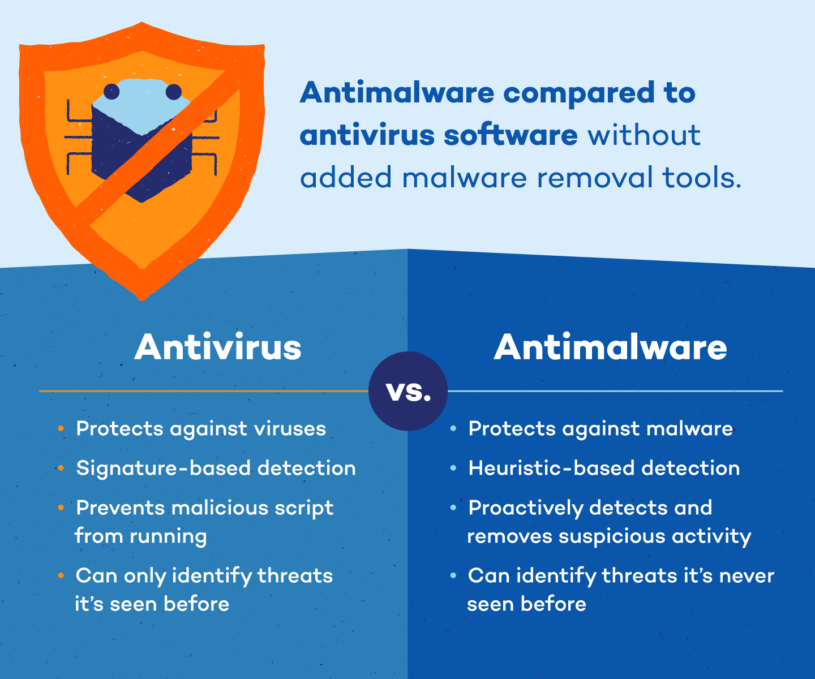
Anti-malware & Antivirus
Notes:
https://www.pandasecurity.com/en/mediacenter/malware/difference-between-antivirus-antimalware/

Slide 73
Guidelines to Network Security
Only run services you need to. When you install an app, you might create an open port. You might forget, put others might poke for vulnerabilities
Make sure you have a firewall that closes ports that the outside world doesn’t need to access
Stay up to date – run updates often and apply security patches immediately
Use “long term support” branches of software – maximizes availability of help & patch / security availability
Don’t create random accounts
Avoid suspicious installation packages / executables

Slide 74
Post-Course Knowledge
https://ostechnix.com/test-your-bash-skills-by-playing-command-line-games/
Over the Wire - Wargames - bandit
https://overthewire.org/wargames/bandit/
Command Line Murders
https://github.com/veltman/clmystery
Learn Git Branching
https://learngitbranching.js.org/
Oh My Git!
https://ohmygit.org/

Slide 75
Stuff we might not have time for, but maybe worth poking through
Obviously everything I think is important is important

Slide 76
tcpdump
https://danielmiessler.com/study/tcpdump/
https://www.digitalocean.com/community/tutorials/how-to-test-your-firewall-configuration-with-nmap-and-tcpdump
https://www.redhat.com/sysadmin/tcpdump-part-one
https://www.redhat.com/sysadmin/tcpdump-part-2

Slide 77
Containers
Install an operating system and all your software inside the container
Put that container on the compute resource of your choice where it will be run
Containers change the user space into a swappable component.
This means that the entire user space portion of a Linux operating system, including programs, custom configurations, and environment can be independent
Each container shares the host OS kernel and, usually, the binaries and libraries
Notes:
https://blog.netapp.com/blogs/containers-vs-vms/

Slide 78

Why Containers?
Bring your own environment
Reproducible science – a good container has everything needed to run your code
Commercially supported code requiring a particular environment
Static environments (software appliances)
Legacy code on old operating systems
Complicated software stacks that are very host specific
Complicated work-flows that require custom installation and/or data

Slide 79


Docker Demo
Install docker (windows needs WSL2)
Create a Dockerfile
Build the container
docker build -t webtest:0.1 .
-t creates a tag, “.” tells build where to find the Dockerfile (current dir)
Run the container
docker run -d -p 5000:80 webtest:0.1
-d detaches, -p specifies local port bind

Slide 80
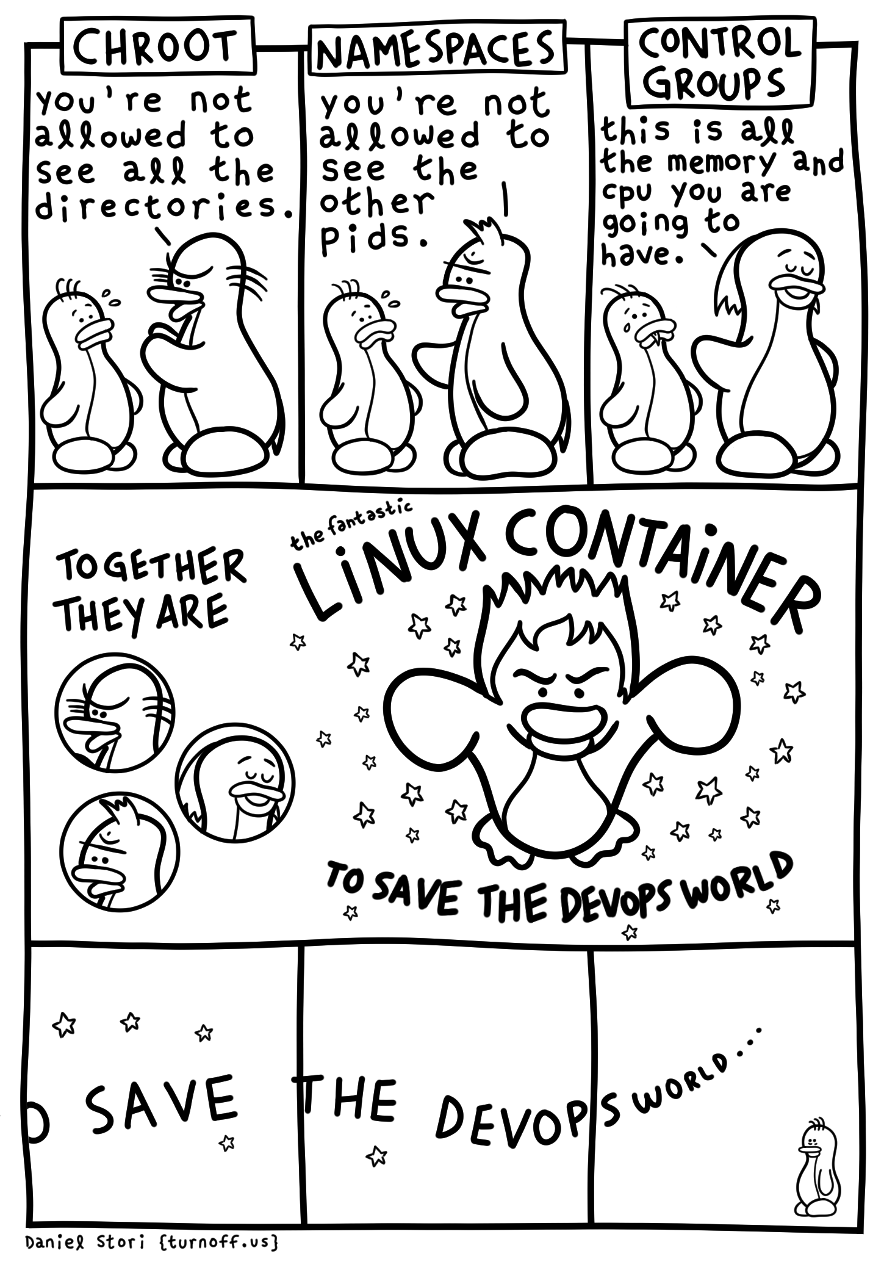
Notes:
http://turnoff.us/geek/linux-containers/

Slide 81
Cloud Computing
AWS - Amazon Web Services
Google Cloud
Azure - Microsoft

Slide 82
System Management

Slide 83
Managing Linux Updates
Linux – package manager is trusted source of packages / software programs
Ubuntu (apt)
$ apt update # updates all package managers
$ apt install package_name # installs that package + dependencies (usually)
$ apt upgrade # upgrades all packages
$ apt list --upgradable # shows list of packages that can be updated
$ apt --only-upgrade install package_name
Upgrade the kernel
Notes:
https://www.cyberciti.biz/faq/ubuntu-upgrade-update-single-package-using-apt-get/
https://www.cyberciti.biz/faq/howto-upgrading-the-ubuntu-linux-kernel/

Slide 84
Managing Windows Updates
You can manage the timeframe, but it will happen.
Never connecting to the internet is the only way
Be aware of Windows update sharing
Takes up bandwidth

Slide 85
Rsync & scp
scp - secure copy (interaction-less ssh + sftp)
$ scp -i demo-key.pem test.txt ubuntu@54.227.255.221:/home/ubuntu/test.txt
rsync – network enabled synchronization tool
Common for creating backups of remote servers
Uses ssh to connect – which means you can use keys!!!
Think sftp without the interaction
https://www.digitalocean.com/community/tutorials/how-to-use-rsync-to-sync-local-and-remote-directories-on-a-vps

Slide 86
dd & clonezilla
dd – convert and copy a file. Seems basic – shines when copying full disks (file systems, the whole shebang)
https://www.geeksforgeeks.org/dd-command-linux/
When you don’t want to show off:
Clonezilla - DRBL
Con: You need to boot to clonezilla
You could install it on a VM… but it’s useless there (hypervisor)
A custom Linux image that provides nice menu options
GUI that covers scripts that actually use dd and rsync
https://www.clonezilla.org/clonezilla-live/

Slide 87
Boot Scripts - Windows
Registry Editor: regedit
HKEY_LOCAL_MACHINE\SOFTWARE\Microsoft\Windows\CurrentVersion\RunOnce
Allows running of a script once (the script will not run on consecutive boots)
If you try to remove the Windows 10 bloatware, people have scripts that fidget with the registry keys to cut off connections to certain Microsoft servers
Never run a script without reading through it for anything suspicious

Slide 88
Boot Scripts - Linux
The most common tool is “crontabs” to create “cronjobs”
These create jobs that happen at a set “every so often”
You can also use them to happen @reboot
http://corntab.com/crontab_examples
There are other ways using /etc/init.d and linking to /etc/rc.d

Slide 89
Open Source Movement
https://en.wikipedia.org/wiki/Open-source-software_movement

Slide 90
RAIDS
Redundant Array of Independent Disks
RAID levels provide a different balance among the key goals: reliability, availability, performance, and capacity
Levels we will look at: 0, 1, 5, 6
Notes:
https://www.digitalocean.com/community/tutorials/an-introduction-to-storage-terminology-and-concepts-in-linux#more-complex-storage-management
https://www.booleanworld.com/raid-levels-explained/
https://en.wikipedia.org/wiki/Standard_RAID_levels

Slide 91
Hardware vs. Software Defined RAID
Hardware raid
Drives plugged in to hardware device, device manages RAID configuration
Software raid
Drives are plugged directly into motherboard, program running on system maintains RAID
mdadm

Slide 92
Striping vs Mirroring
Striping - splitting data across drives
Mirroring - a copy of a chunk of data on another drive

Slide 93
Calculating Parity
For example, suppose two drives in a three-drive RAID 5 array contained the following data:
Drive 1: 01101101
Drive 2: 11010100
To calculate parity data for the two drives, an XOR is performed on their data:
01101101
XOR 11010100
_____________
10111001
The resulting parity data, 10111001, is then stored on Drive 3.
Notes:
https://en.wikipedia.org/wiki/Parity_bit#Redundant_array_of_independent_disks

Slide 94
Using Parity Calculation
Should any of the three drives fail, the contents of the failed drive can be reconstructed on a replacement drive by subjecting the data from the remaining drives to the same XOR operation. If Drive 2 were to fail, its data could be rebuilt using the XOR results of the contents of the two remaining drives, Drive 1 and Drive 3:
Drive 1: 01101101
Drive 3: 10111001
as follows:
10111001
XOR 01101101
_____________
11010100
The result of that XOR calculation yields Drive 2's contents. 11010100 is then stored on Drive 2, fully repairing the array.
Notes:
https://en.wikipedia.org/wiki/Parity_bit#Redundant_array_of_independent_disks

Slide 95
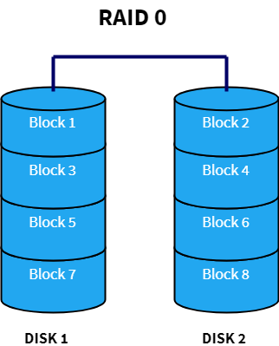
RAID 0
Data split evenly among disks
Limited to 2 x size of smallest disk
When system reads data, it is done simultaneously from all the disks
Joins reads together to reconstruct the entire data stream
Speed increases drastically for read and write operations
No redundancy

Slide 96
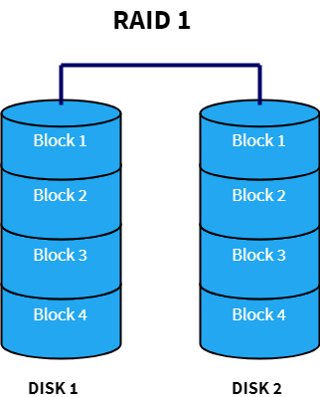
RAID 1
Data is mirrored / duplicated among disks
Increased performance for read operation
Slow write performance

Slide 97
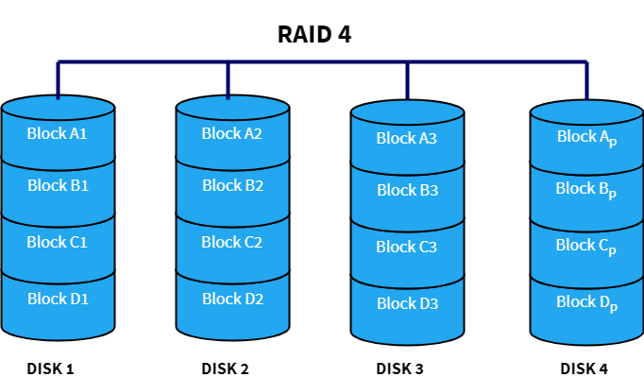
RAID 4
All parity is stored on one disk
Data is striped across disks (like RAID 0) - performance boost for reads
Write performance slow because all the parity information is written on a single disk (bottleneck)
If the dedicated parity disk fails, data redundancy is lost

Slide 98

RAID 5
Parity information is distributed across disks
All the advantages of RAID 4 plus increased write speed and better data redundancy
Can only handle up to a single disk failure

Slide 99
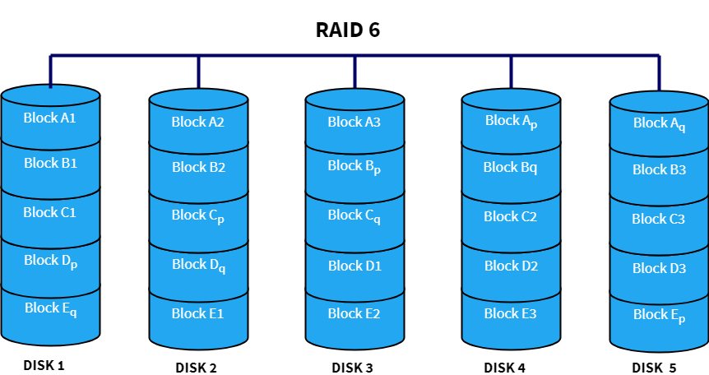
RAID 6
Double parity with double mint gum
Can handle two disks failing
Each disk has two parity blocks which are stored on different disks across the array
Write performance takes a hit

Slide 100
Neat things about RAIDs
Not all disk types handle raid configurations well
NVME drives are not currently great in RAID levels that need redundancy
HDDs and SSDs are still cornering the market for flexible use with RAIDs

Slide 101
Now that you have your RAID
Needs a partition
Needs a filesystem

Slide 102
OpenSource
https://i.redd.it/toglggqhuik71.jpg

Slide 103
Reference Links for later
https://en.wikipedia.org/wiki/Computer_architecture
https://www.seeedstudio.com/blog/2020/02/24/what-is-x86-architecture-and-its-difference-between-x64/
https://www.digitaltrends.com/computing/32-bit-vs-64-bit-operating-systems/
https://www.techadvisor.com/feature/pc-components/32-bit-vs-64-bit-3584953/

Slide 104
Line endings
Save for talking about binaries
For program output, you have been using \t, \n, etc.
Giving you tabs and newlines
In the beginning, Microsoft and Unix / Linux had different line endings
\r vs \n
Who is right? Well, if they are hidden, and one can’t interpret the other, the one you need to use is right
https://stackoverflow.com/questions/14219092/bash-script-and-bin-bashm-bad-interpreter-no-such-file-or-directory
https://stackoverflow.com/questions/6998506/text-file-with-0d-0d-0a-line-breaks

Slide 105
Shell exercises
https://www.codewars.com/?language=shell

Slide 106
Linux Kernel & Lessons in Open Source
https://github.com/torvalds/linux
Maybe also talk about for GDB?
https://thenewstack.io/checking-linuxs-code-with-static-analysis-tools/
-fanalyzer support?

Slide 107
ISO - Image Files
https://www.howtogeek.com/356714/what-is-an-iso-file-and-how-do-i-open-one/
https://www.lifewire.com/iso-file-2625923

Slide 108
Functions
function func_name {
Stuff_to_do;
}
func_name () {
Stuff_to_do
}
Call to run
https://tldp.org/LDP/abs/html/functions.html
https://tldp.org/HOWTO/Bash-Prog-Intro-HOWTO-8.html
Notes:
https://bash.cyberciti.biz/guide/Pass_arguments_into_a_function

Slide 109
Pass an argument into a function
Much like $1 can be used to check arguments when script is called, can also use $1 to access values passed to a function
script.sh “Hello World”
$1
function_name “my string”
function_name () {
$1
}
Notes:
http://www.compciv.org/topics/bash/loops/

Slide 110
Disk Discussions
https://arstechnica.com/gadgets/2021/08/silent-changes-to-western-digitals-budget-ssd-may-lower-speeds-by-up-to-50/
https://www.reddit.com/r/explainlikeimfive/comments/pecfck/eli5_why_do_windows_based_pcs_and_laptops_appear/

Slide 111
Makefile specialties
Avoid confusion between targets and existing files with phony
https://www.gnu.org/software/make/manual/html_node/Phony-Targets.html
Makefiles can work on multiple files
http://web.mit.edu/gnu/doc/html/make_2.html

Slide 112
So someone sent you their compiled program
And never wrote what dependencies it has
$ ldd (LDD) – prints shared object dependencies (shared libraries) required by the program & dependencies of those dependencies
Try $ ldd /bin/ls
Note: may not work with java programs ☹

Slide 113
Installs
Gcc for Windows: MinGW
JDK for Windows: via Oracle, OpenJDK, AWS JDK
JDK vs JRE
Java Development Kit vs Java Runtime Environment
JDK comes with JRE - JRE is what you need to run bytecode in JVM
Linux:
$ apt install openjdk-14-jdk
$ apt install gcc
Windows users need to install each compiler in WSL2 & Windows
Notes:
https://www.eclipse.org/4diac/documentation/html/installation/minGW.html
https://sourceforge.net/projects/mingw-w64/

Slide 114
Mac Installs
Untested solutions:
gcc: xcode-select --install
Maybe homebrew? https://discussions.apple.com/thread/8336714
Java: https://java.com/en/download/apple.jsp
https://jdk.java.net/15/
Notes:
https://discussions.apple.com/thread/8336714

Slide 115
For the explorers (can ignore)
Colors:
https://github.com/nanotech/jellybeans.vim
Colorschemes are a nice easy thing to set that makes you feel fancy
Code syntax in vim: Syntastic
https://github.com/vim-syntastic/syntastic
Is a real bear if switching between python2 and python3
May require compiling vim with added features (see docs)
Handy for python coders:
isort - sorts imports when passed a python file (does for you)
black - checks python formatting (does for you)
pylint - checks formatting against PEP 8 standard (just yells at you)
Notes:
https://pypi.org/project/isort/
https://github.com/psf/black
Other resources:
https://askubuntu.com/questions/340940/installing-pylint-for-python3-on-ubuntu
https://stackoverflow.com/questions/23177561/switch-python-version-for-vim-syntastic
https://github.com/vim-syntastic/syntastic/issues/1412

Slide 116
Reverse Engineering
https://0x41.cf/reversing/2021/07/21/reversing-x86-and-c-code-for-beginners.html
Core dumps:
www.cyberciti.biz/faq/disable-core-dumps-in-linux-with-systemd-sysctl
www.tomshardware.com/amp/how-to/use-windows-debugger

Slide 117
Random Numbers & Entropy
https://linuxhint.com/dev_random_vs_dev_urandom/
/dev/random
Truer random, crypotographically random enough
/dev/urandom
Lazy random. Okay for code where you need random, but not really random
Random is a much bigger concern for machine learning or cryptography
In ML, you want the model to train from unbiased start points

Slide 118
Encrypting Files with Keys (PGP & GPG)
Windows: PGP
https://www.geeksforgeeks.org/pgp-compression/
Linux: GPG
https://www.geeksforgeeks.org/encrypting-and-decrypting-the-files-using-gnupg-in-linux/

